Slide 1

Data Abstraction in DBMS
Simplifying Database Interaction by Hiding Complexity
Farjan Ahmmed
ID : 232-35-738

Slide 2


Introduction to Data Abstraction
Definition : Data abstraction is the process of hiding complex details of database storage and operations while providing a simplified interaction interface.
Importance :
  Enhances security
  Reduces complexity
  Provides multiple views for different users

Slide 3



Why Data Abstraction is Needed
Hides Internal Storage Mechanisms
Provides Different Views to Different Users
Improves Security by Restricting Access
Users do not need to know how data is physically stored
End-users see relevant information.
Prevents unauthorized access by controlling what users can view or modify.
Simplifies interaction by abstracting complex storage structures.
Database administrators and developers also see relevant information.
Ensures that sensitive data remains protected from unintended users.

Slide 4
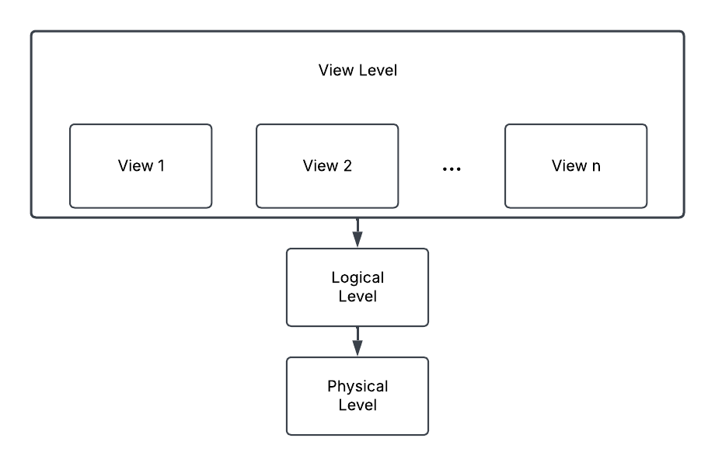
Three Level of Data Abstraction
Highest Level
Middle Level
Lowest Level

Slide 5

Physical Level
Describes how data is stored (files, indexes, pages).
Defines complex low-level data structures.
Known as the physical schema.

Slide 6

Logical Level
Defines what data is stored and relationships
Known as the conceptual schema (single schema for the database).
Used by database administrators to manage database structure.

Slide 7

View Level
Defines how users see the data (external schema).
Hides complexity and provides multiple views for different users.
Can restrict access to sensitive data for security.

Slide 8

Advantages of Data Abstraction
Simplifies database management.
Enhances security and access control.
Improves data independence and flexibility.
Reduces application maintenance efforts.

Slide 9



Real-life Examples of Data Abstraction
Banking Systems: Customers view transactions, but backend details remain hidden.
E-commerce Platforms: Users see product listings, not the database structures.
Healthcare Systems: Doctors access patient records without seeing underlying storage mechanisms.

Slide 10

Thank You

